Slide 1

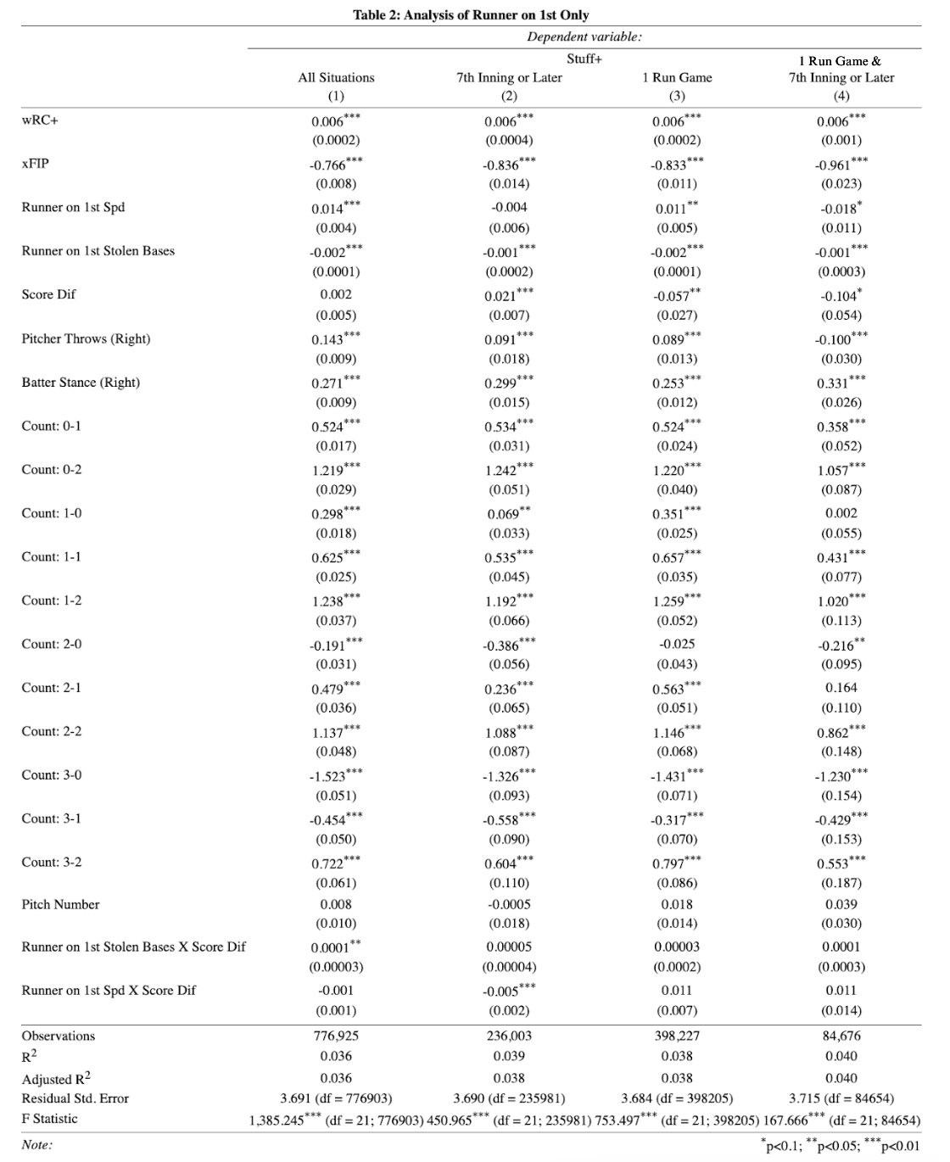
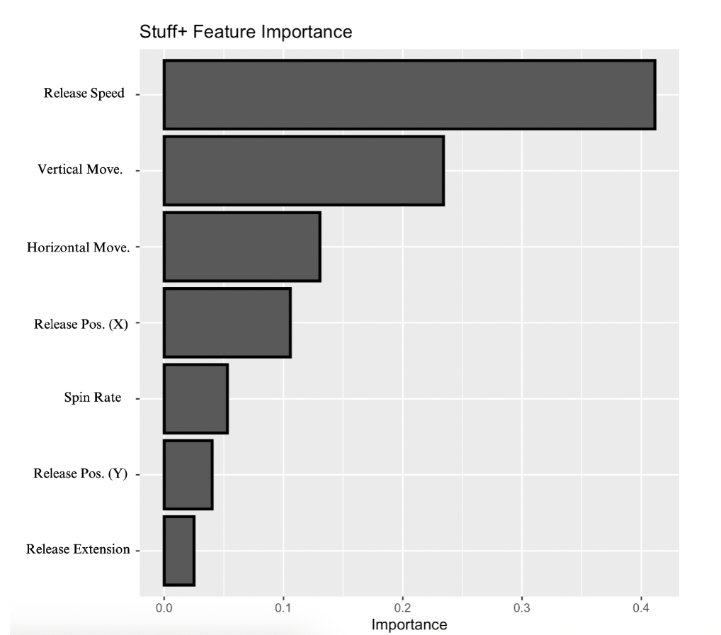
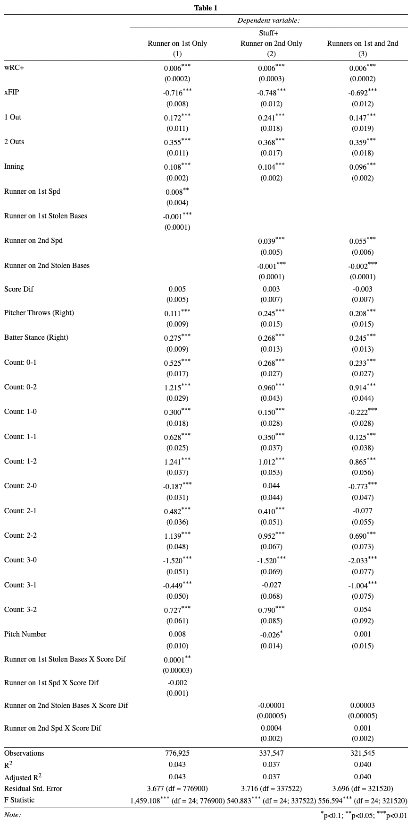
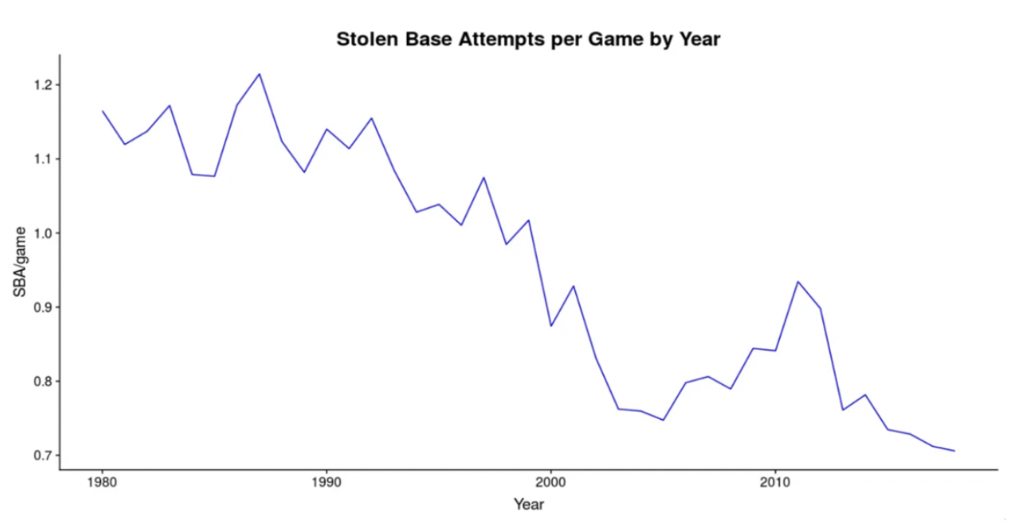
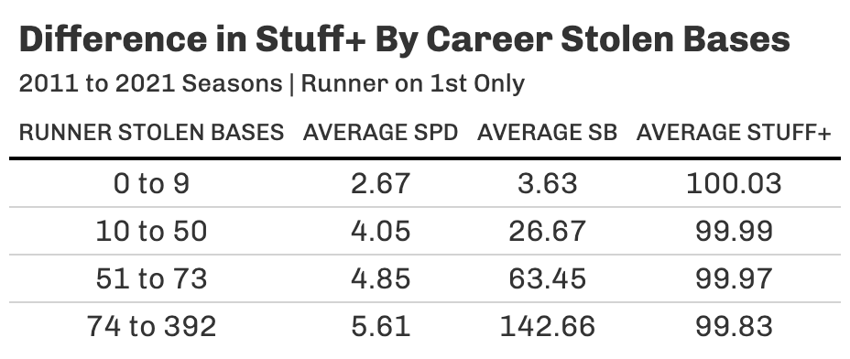
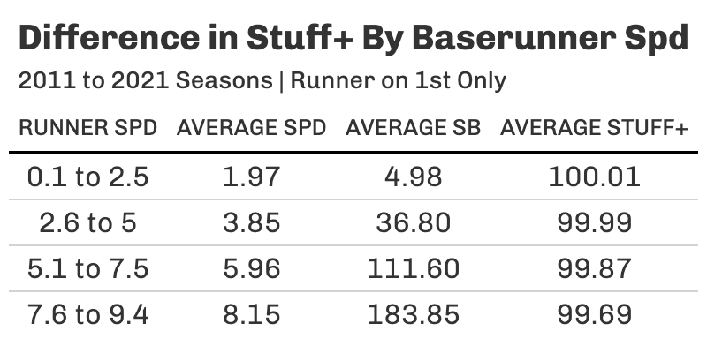
Understanding the Effects of a Stolen Base Threat on Pitcher Pitch Quality
Alexander Borelli Falk College of Sport and Human Dynamics, Syracuse University
ABSTRACT
The goal of this research paper is to determine whether characteristics of the base runner, such as their speed and stolen base tally, has any influence on the pitcher’s pitch quality. We analyze the effects of the threat of a stolen base on the quality of a pitcher’s pitch using Major League Baseball (MLB) play-by-play data from the 2011 through 2021 seasons. From our research we find evidence to suggest that pitcher pitch quality decreases slightly in stolen base situations and that that effect is greatest for when there is a runner on first only and when it is a one run game. These effects are also present as you increase the base runner speed in late game situations and are even greater as you increase the number of stolen bases in all situations. In the 7th inning or later and a one run game, speed becomes more influential than stolen bases in affecting pitch quality, which we conclude that pitchers may feel more “pressure” from the runner despite them not being an active base stealer.
METHOD
The first step in my analysis was to create the Stuff+
metric. Most pitch quality metrics aren’t publicly
available, however, Eno Sarris of The Athletic has
provided the variables and methodology to create his
popularized Stuff+ metric. Using an XGBoost model and
regressing swinging strike on various pitch tracking
variables, we achieve our raw stuff metric. Then adjusting
this number for season and placing it on a 100 scale we
get our Stuff+ number. The variables and their
importance are provided below.
After acquiring the Stuff+ metric, I then merged this
data with our pitch-by-pitch data and filtered it to
various stolen base situations: runner on first, runner on
second, runner on first and second. I then used a linear
regression model and regressed Stuff+ on a few factors
that may influence pitch quality, specifically the
FanGraphs runner speed and stolen base number. The
effects are analyzed in these three stolen base situations
as well as in various game situations. We look at how
these variables change in late game situations, close
games, and when the game is a one run game and in the
7th inning or later.
RESULTS
The results in our model display evidence to suggest that the number of stolen bases by the baserunner is indicative of having an effect on pitcher pitch quality. We find that a one stolen base increase leads to a 0.001 decrease in Stuff+ for a runner on first only and that effect decreases to 0.002 for the runner on second with runners on first and second. The coefficient is negative and statistically significant for the lead runner in all three stolen base situations.
When looking at various game situations, we experience similar or even greater effects. As seen in the table to the right, the second model, which is constricted to just 7th inning or later, the runner on first stolen base total is negative and statistically significant. We also experience the runner on 1st speed rating showing signs of a negative effect on pitcher pitch quality. In the situation of 7th inning or later and 1 run game, Stuff+ decreases by 0.018 for every 1 spd increase.
We also see the interaction term between spd and score difference be negative and statistically significant. This coefficient is the greatest magnitude of all base runner variables throughout our models. This confirms our hypothesized ”pressure effects” as pitchers seem to have their pitch quality influenced in more important situations. As a game gets later and the score is within a run, pitchers typically experience greater pressure of succeeding a stolen base and experience a worse Stuff+.
RESULTS CONT.
INTRODUCTION
Stolen bases and stolen base attempts have been decreasing continuously over the last few decades. The evidence provided to negate the worth of a stolen base has focused solely on the value of an out versus the value of the additional base. However, not much research has been done to understand if there are any external influences that add additional benefits to the batting/base stealing team.
By utilizing Stuff+, a popular pitching metric that aims to capture the quality of a pitch in one number, we can analyze whether pitcher pitch quality decreases when there is a runner on first, second, or first and second. From there, we can test whether the speed or number of stolen bases for that lead runner matters and if so, in which scenarios that effect is greatest.
This research aims to provide an alternative perspective to the stolen base and potentially provide offenses more information as to how pitcher pitch quality may be influenced by the base runner.
CONCLUSION
The purpose of this research was to evaluate possible influences in the stolen base setting and how pitcher pitch quality is affected by them. Each model analyzes how certain variables play a role on the dependent variable, Stuff+, and how significant these certain base runner characteristics are when it comes to disrupting the pitcher.
Our findings display how pitchers do indeed tend to experience a decrease in pitch quality when there is a stolen base threat. These effects are even more noticeable in late close game situations which confirm our idea of the threat of a stolen base negatively influencing pitch quality.
These findings can potentially help improve offensive strategy and ultimately create more stolen base attempts due to its influences.
REFERENCES
Sarris, E. (2021, June 11). The pitcher report: What exactly is stuff+? featuring Rich Hill, Sam Long, and more. The Athletic. Retrieved November 15, 2022, from https://theathletic.com/2641834/2021/06/11/the-pitcher-report-what-exactly-is-stuff-featuring-rich-hill-sam-long-and-more/
Loughin, T. M., & Bargen, J. L. (2008). Assessing pitcher and catcher influences on base stealing in Major League Baseball. Journal of Sports Sciences, 26(1), 15–20. https://doi.org/10.1080/02640410701287255
Wilson, J. (2017, March 16). Measuring the quality of a pitch. The Hardball Times. Retrieved November 15, 2022, from https://tht.fangraphs.com/measuring-the-quality-of-a-pitch/
Notes:
Template for a 48” x 36” poster

